Slide 1
Advanced Air Academy 2010
Through the eyes of Noemi Zuniga and Nicholas Bettencourt

Slide 2
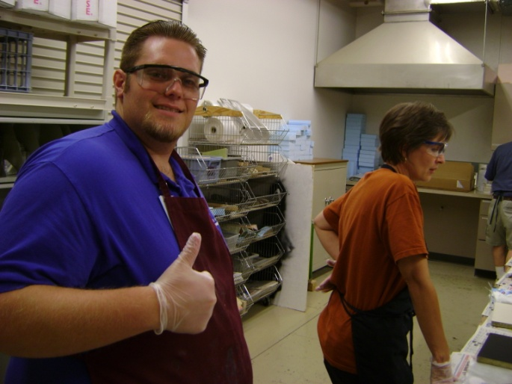
First Impression
Really big
Staff was very welcoming
Rooms where great
Everything felt safe
It was like being part of and extended family
Best of all the food was awesome

Slide 3
Overview
At the Lodge
Class Room
Workshops
Team Building
Flying
Air venture and the museum

Slide 4
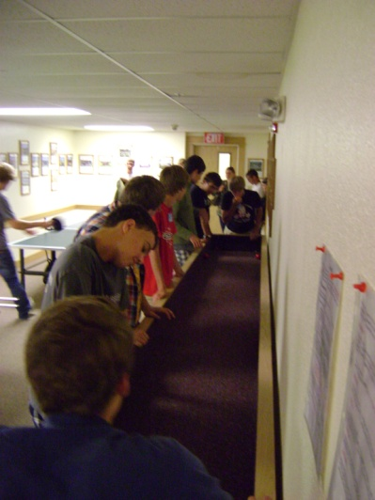
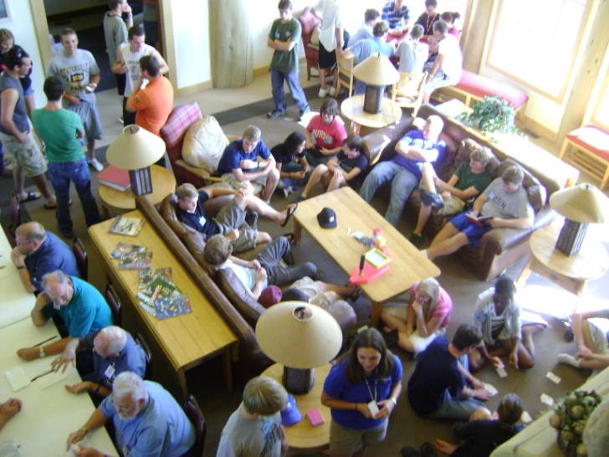
At the Lodge
We could do so many things like:
Carpet ball, Pool, Foosball, Ping-Pong
Flight simulators
Card games
Hanging out
Fishing, Frisbee and more!!!
The rooms where amazing:
Everyone had their own space
Everything felt safe
Food was GREAT
Home made
Dessert everyday!!
Great bonding opportunity
Staff, Directors and campers all got along great
We were all on the same level
Every one showed respect an manners
Staff was fun

Slide 5
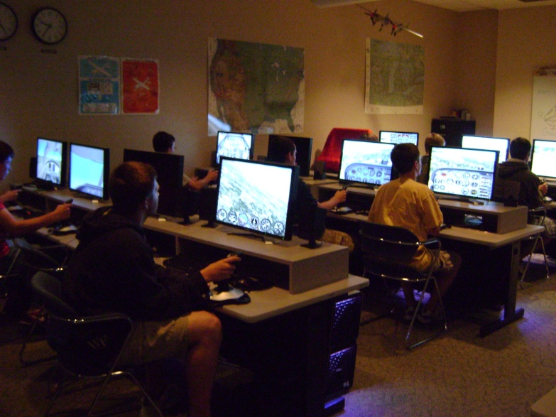
Class Room
Brian Lee- engineer, our teacher
Weather
Relation with aviation, how and where to get it, how to read it, safe not safe
Structures
Connection to workshops, shape and size change airplane
Cool Pics and stories
Previous jobs
Cool airplanes

Slide 6
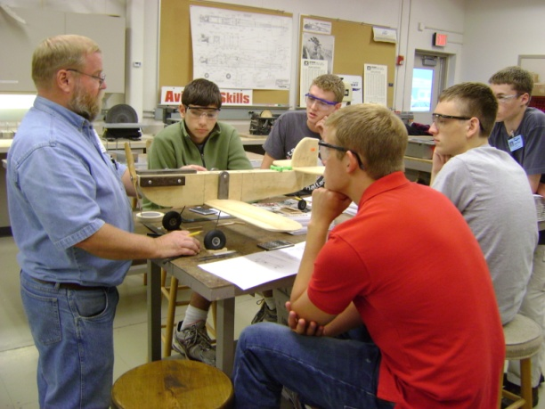
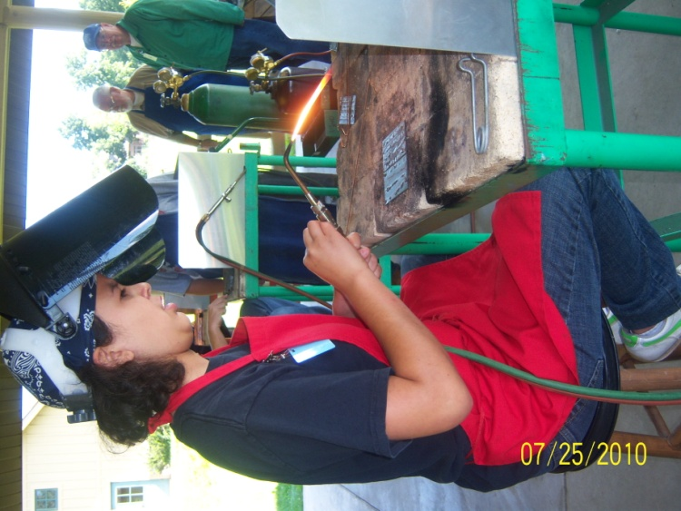
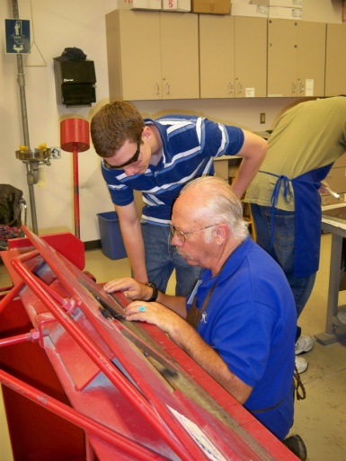
Workshops
Compost
Clipboards
Airplane parts: lighter, strong, easy to get
Wood Working
Wing rib
Many designs, long history, developed, changes air flow
Sheet Metal
Spark plug tray
Drill press, cleco clamps, center punch
Aviation Technology
Center of gravity, safe and legal flying situations and weights
Welding
Simple techniques, on and off

Slide 7
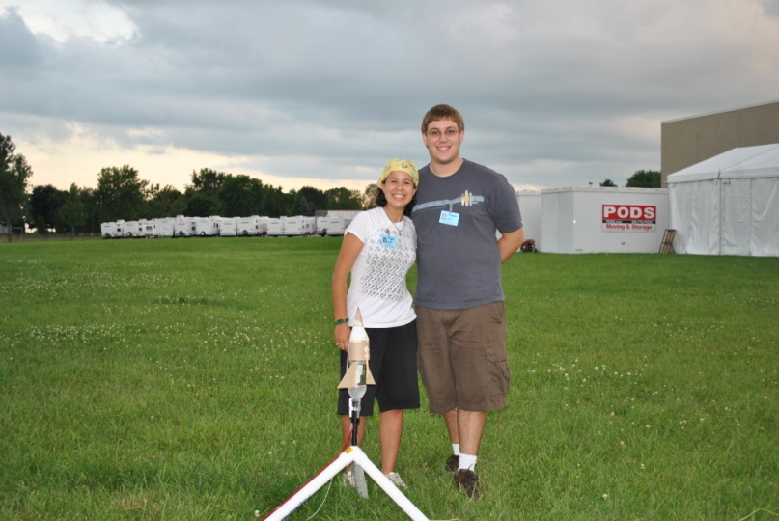
Team Building
Ice breakers
Name games, introductions, room activities, conversations at meals
Sports
Organized and random
Soccer, volleyball, Frisbee, capture the flag
Lower ropes courses
Trust exercises, strategy, spider web activity, save ducky
Pressurized rockets
build rocket that will fly and land safely and protect egg
Limited supplies
Gliders
Design and build a glider
Must fly or stay in air

Slide 8
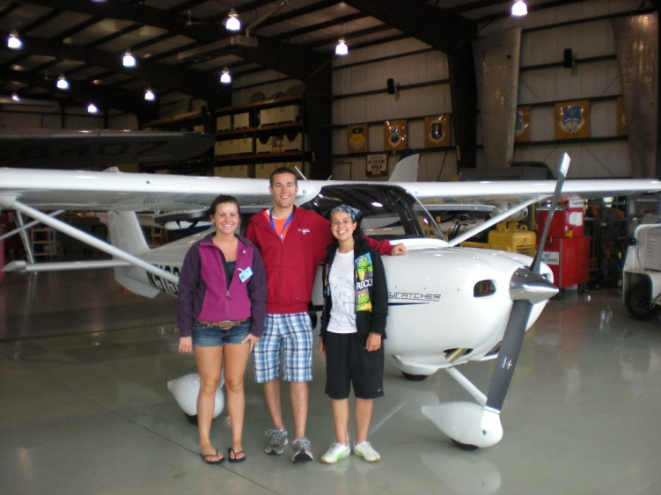
Flying
Pre Flight
Whole process run trough with assistance of pilot
Flight
All you
Complete maneuvers instructed by staff
Questions answered
Translations used when necessary
Hanging with the pilots
We had a… situation and… we hung out till it was over
We saw planes up close
Dream come true

Slide 9
Airventure and the Museum
We can talk about this one…. Because really, you have to be there so experience it
We have some videos and some pictures to give you a glimpse
http://www.youtube.com/watch?v=oEDGMxYaO5Y

Slide 10
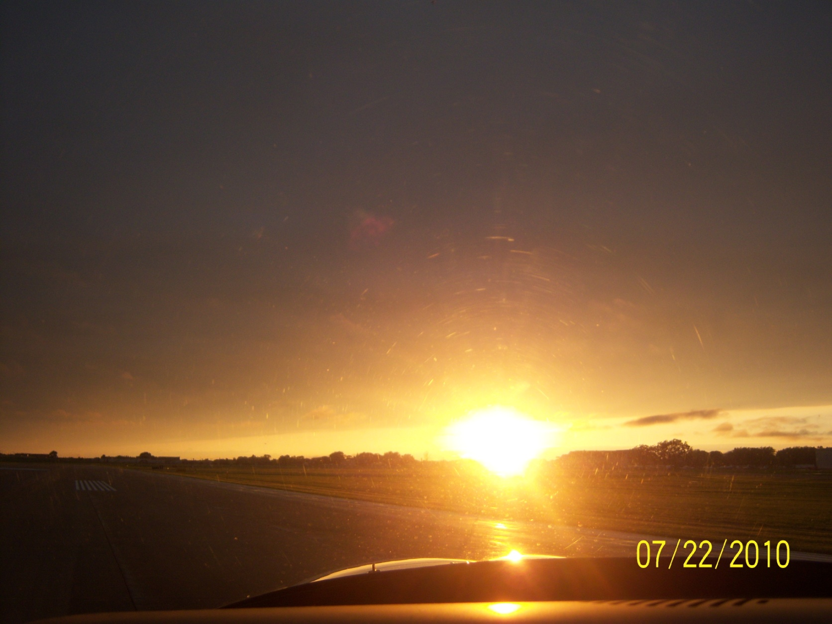
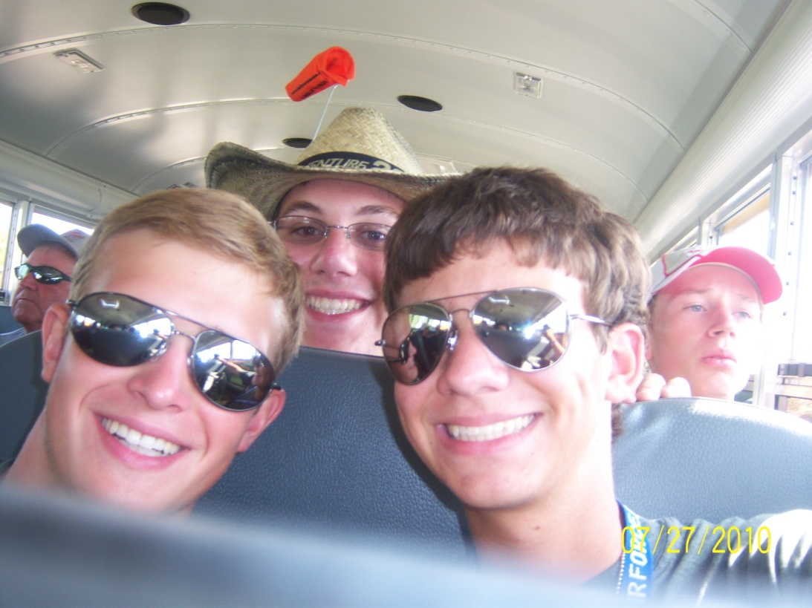
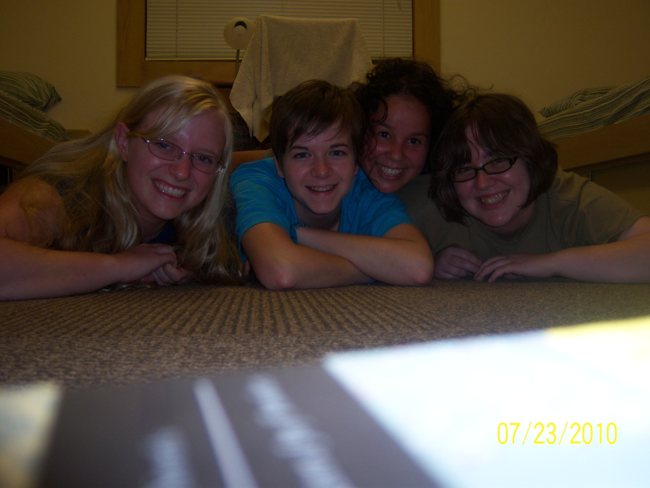
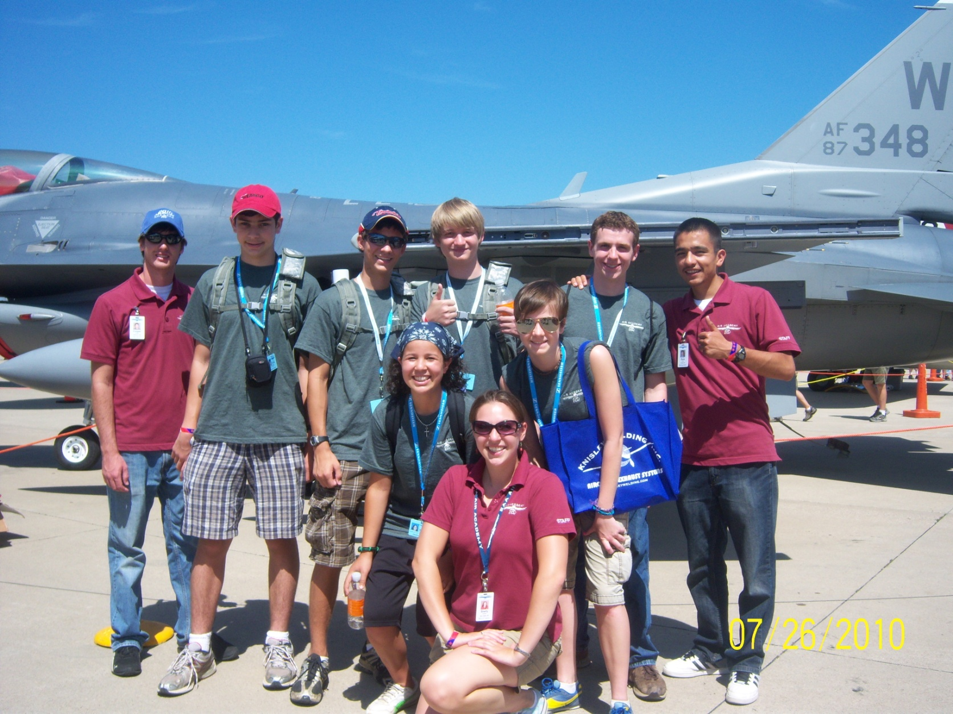
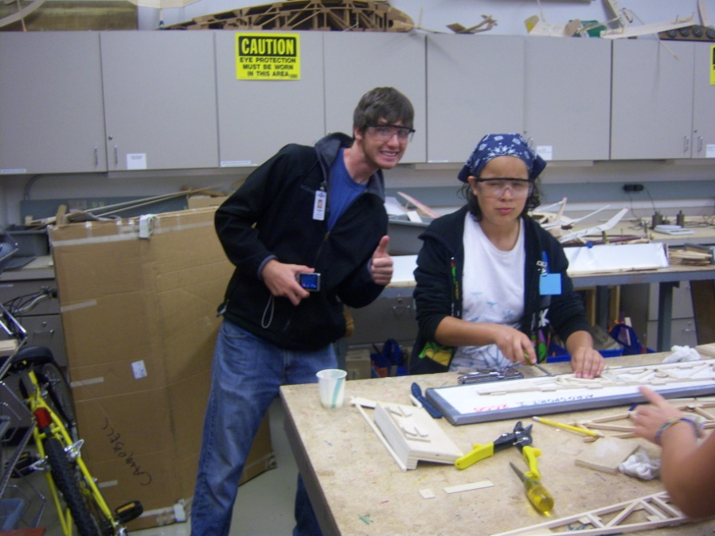
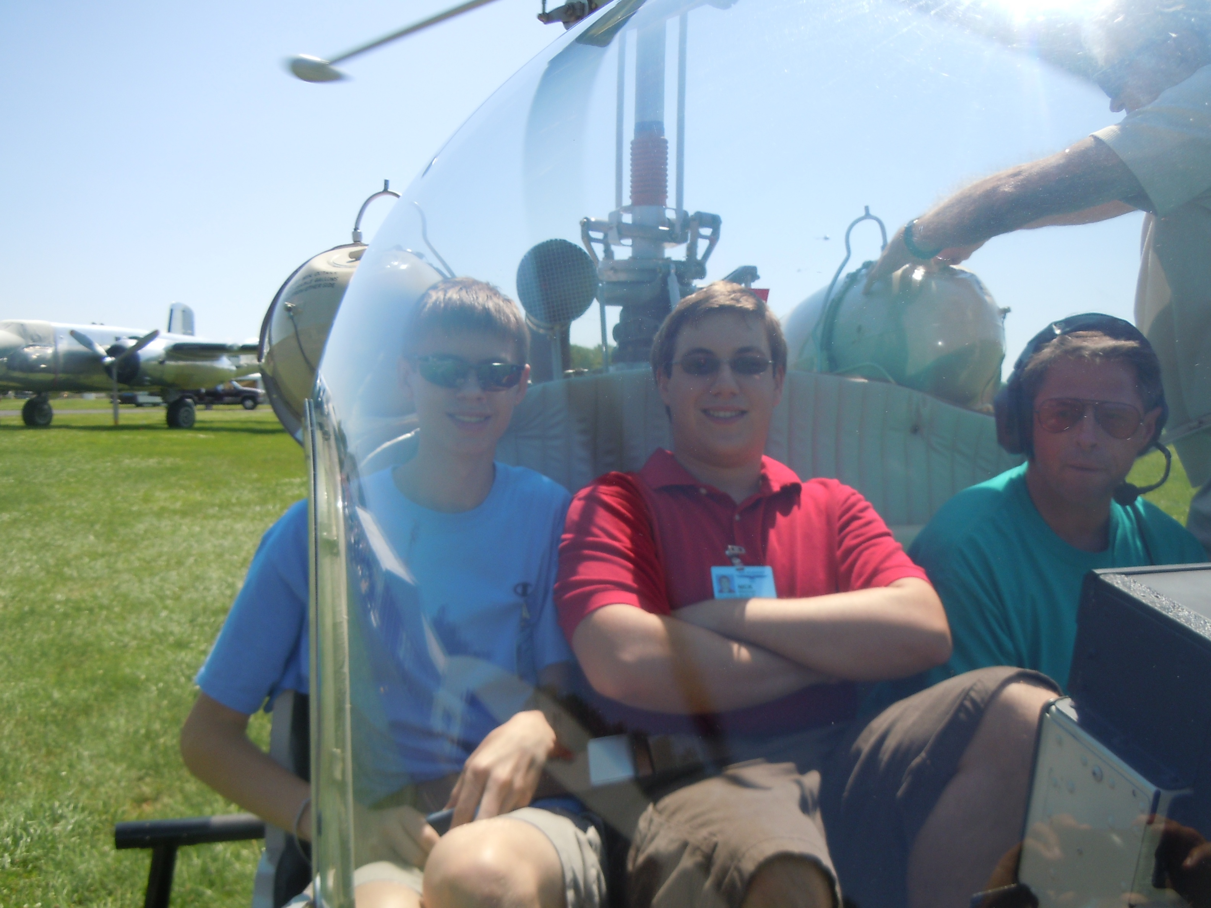
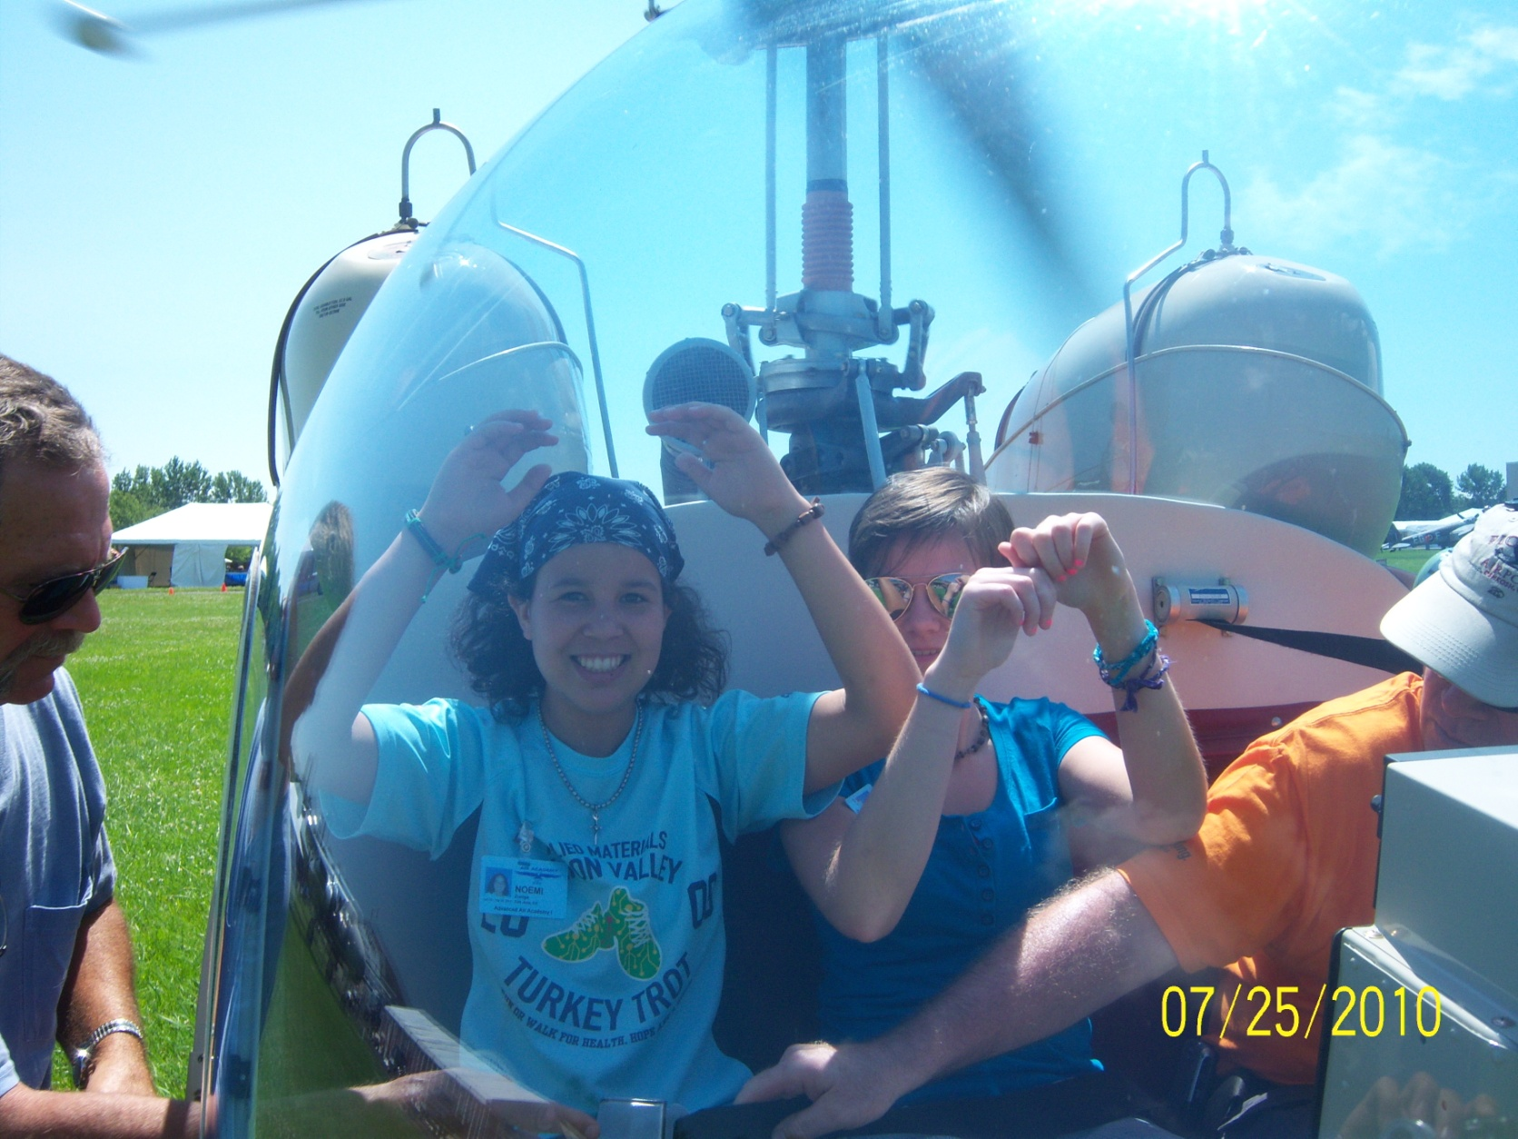
The lasting effect
The people we met
The friends we made
The heroes we discovered
Memories that we created
Everything we learned
Getting closer to our dreams

